Slide 1
SE 361 Sprint #3 Review
Code Monkeys in Tech Support

Slide 2
Sprint Goals
Finalize forgot password
Finalize user registration
Implement multiple screens based on user type
Implement functionality for tickets (partially complete)

Slide 3
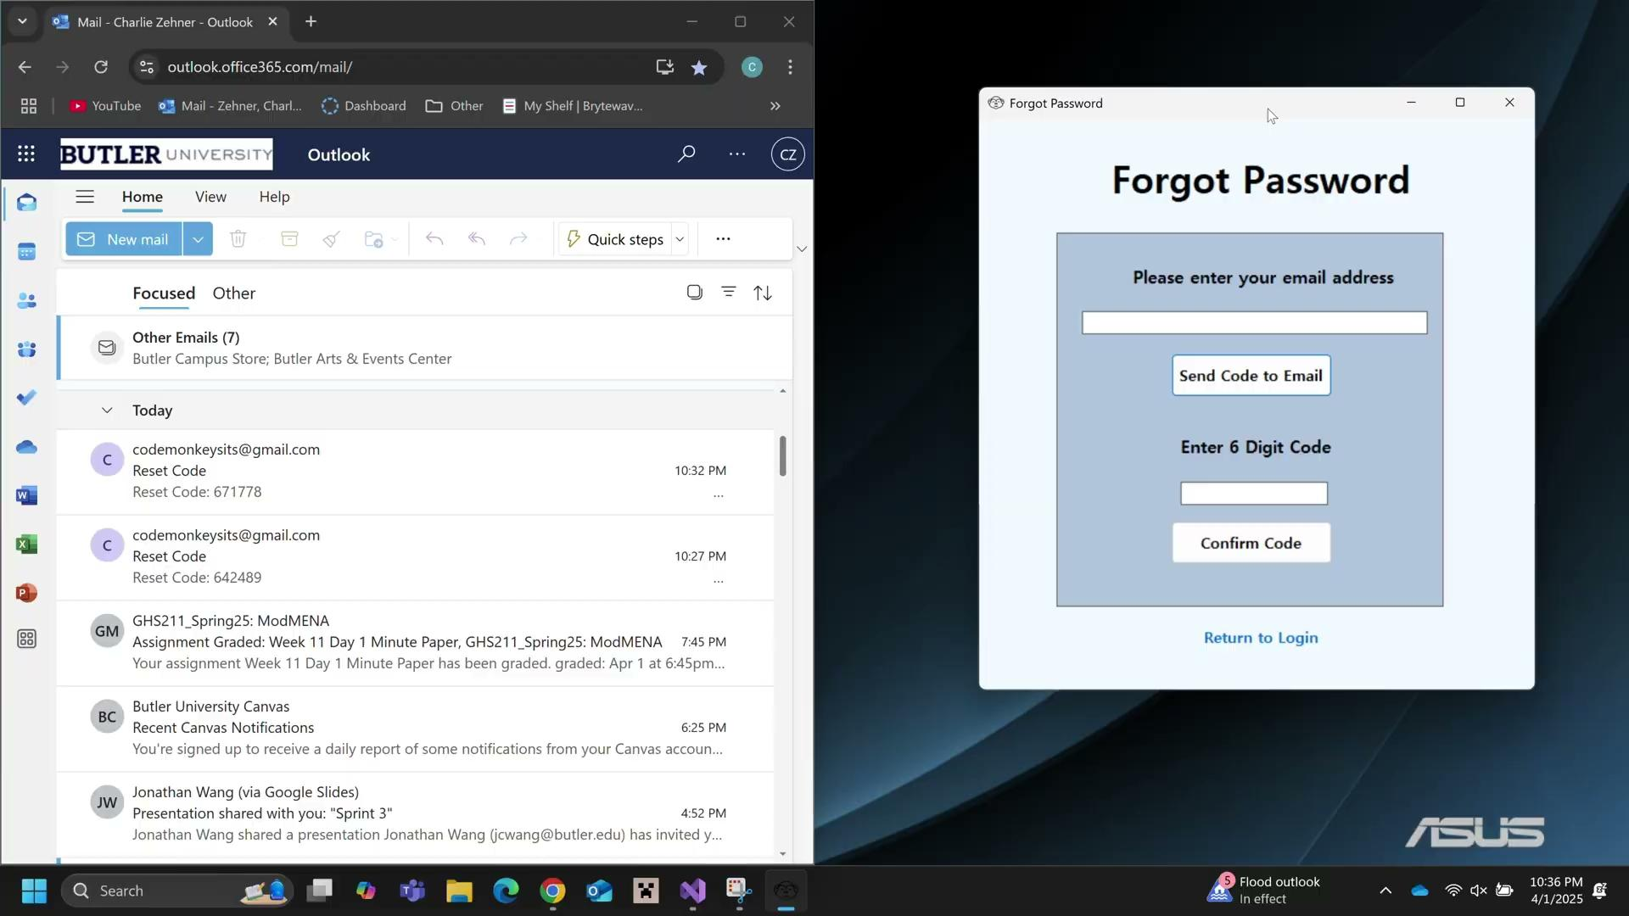
Forgot Password Demo

Slide 4

User Registration Demo

Slide 5
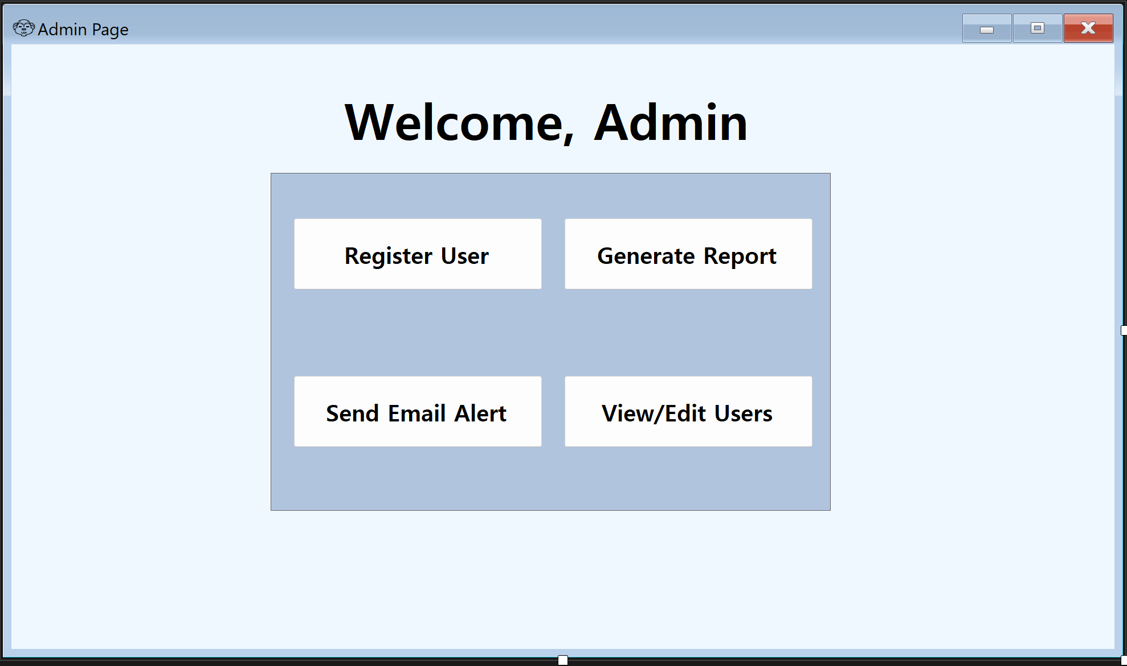
Admin Page

Slide 6
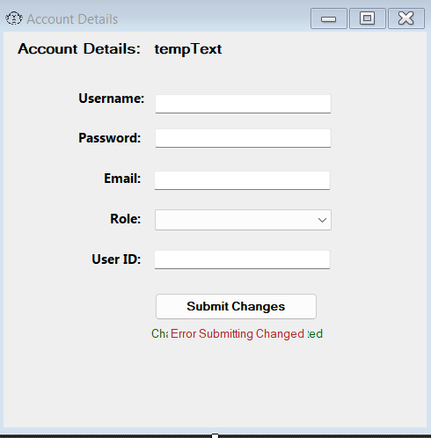
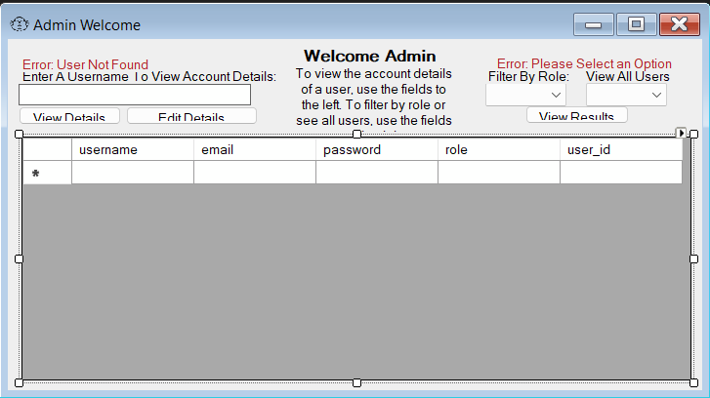
frmViewUsers
frmEditDetails

Slide 8
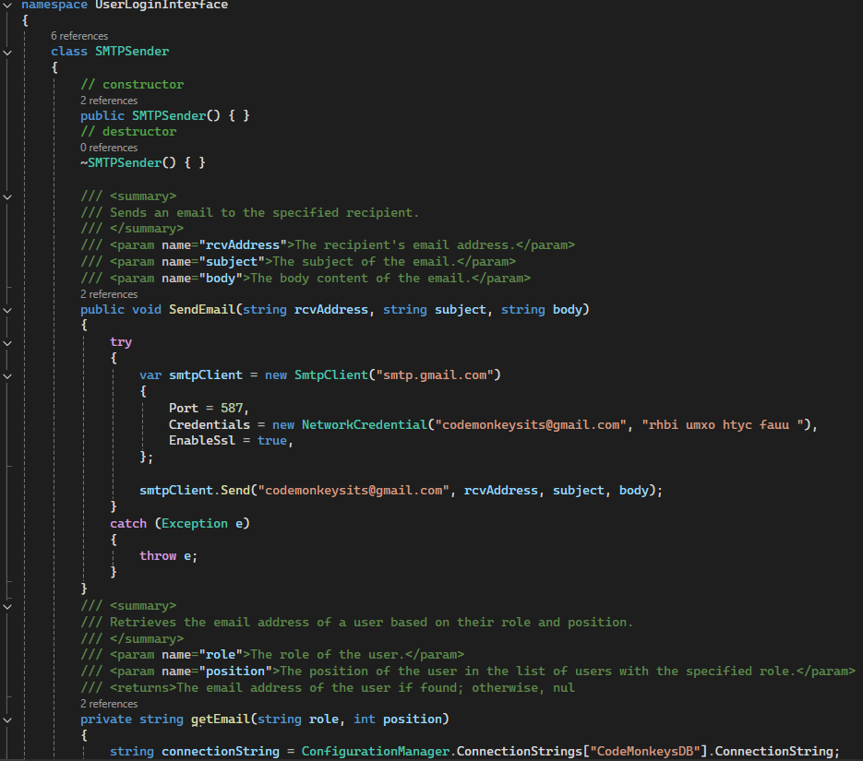
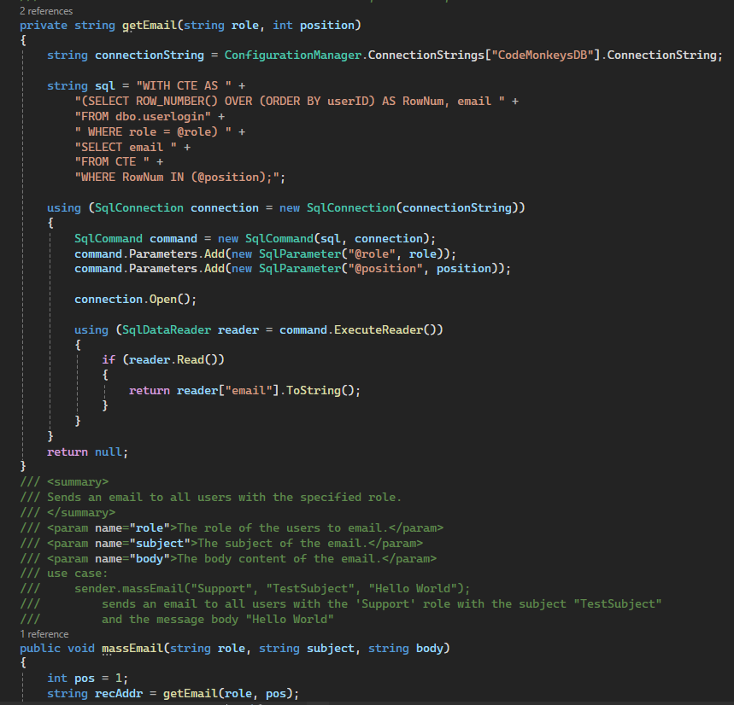
Email Class

Slide 9
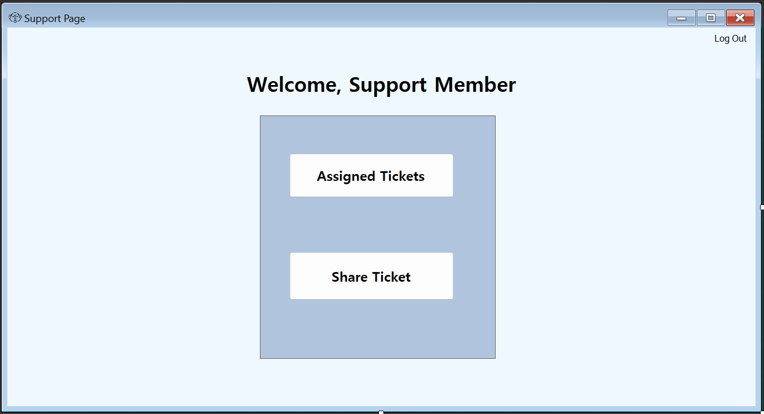
Support Team Page

Slide 10
Future Goals
Add more ticket functionality
Reporting managers can assign tickets
Support staff can share tickets
Support staff can update ticket status
Users can view tickets
Continue updating the design for different user types
Add frequent issues page

